Slide 1



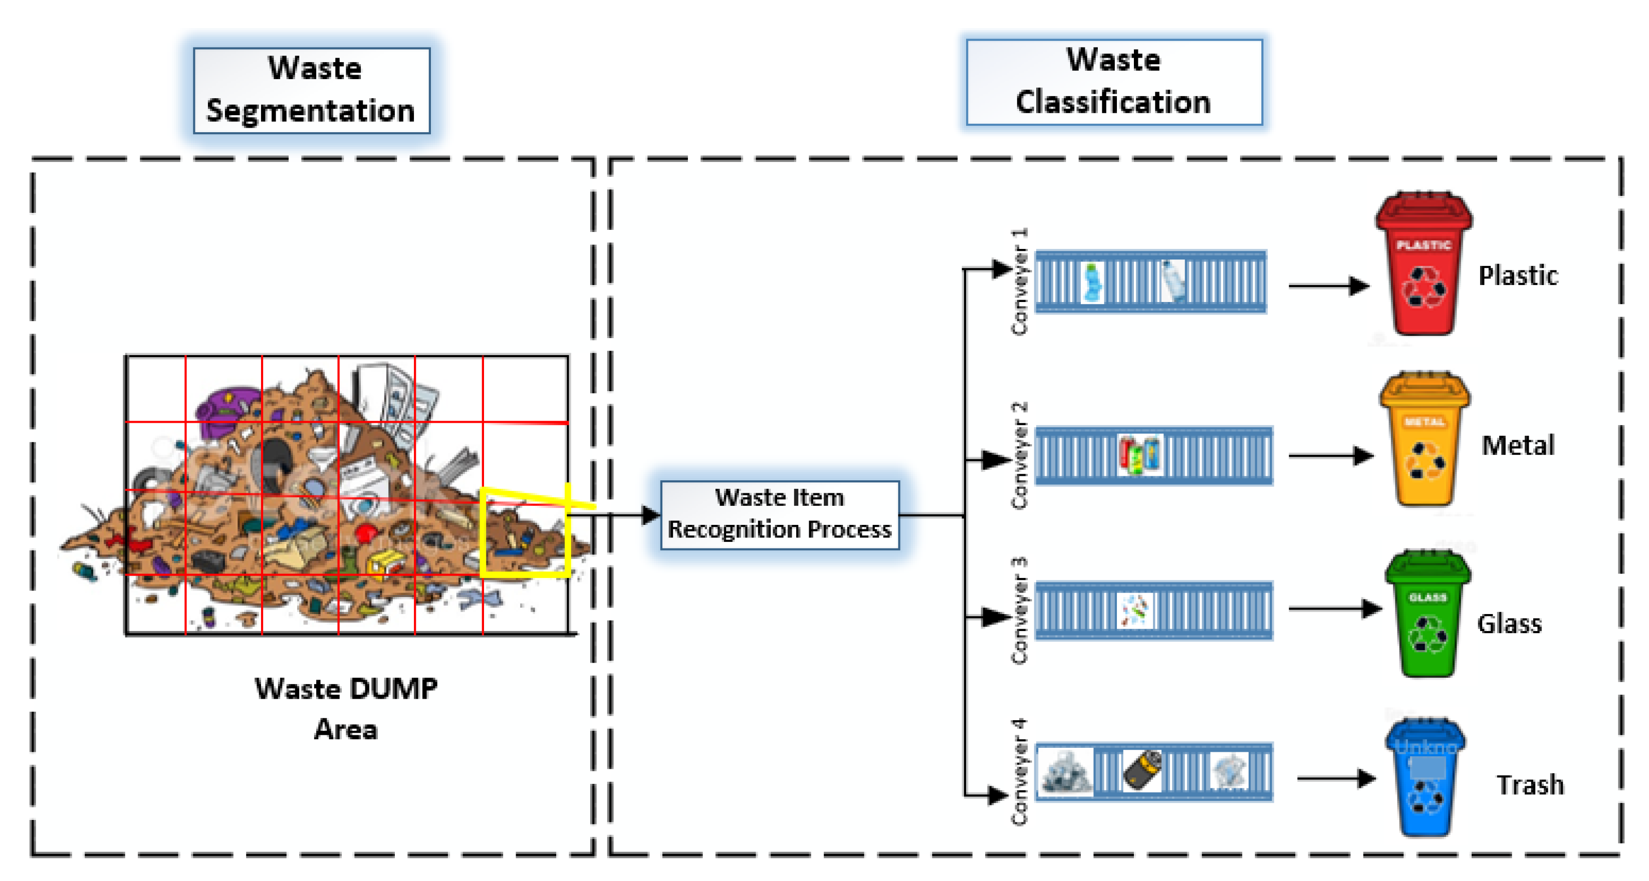
Name of Project :Waste classification management
Subtitle: Automated organic vs. recyclable sorter Name:Mohd Farrakh Nizam
• July 2025 • CEC jhanjeri,mohali

Slide 2
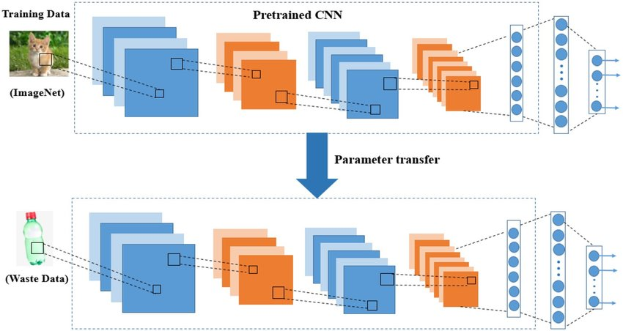
Learning Objectives:
Understand how deep learning can automate waste classification.
Learn to preprocess and augment image datasets.
Gain practical experience with Convolutional Neural Networks (CNNs).
Evaluate the impact of AI on environmental sustainability.
Explore how educational tools can promote better recycling behavior.

Slide 3
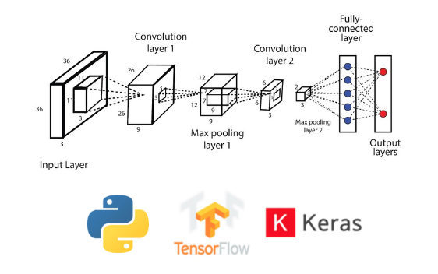
Tools and Technology used :
This project leverages a wide range of modern technologies to implement and deploy the waste classification system:
Python – Core language for development
TensorFlow – Deep learning framework used for CNN modelling
OpenCV – For image preprocessing
Google Colab – Used for development and experimentation
Pandas & NumPy – For data handling and augmentation
Matplotlib / Seaborn – For visualizing model performance
Kaggle – Source of the labeled dataset

Slide 4
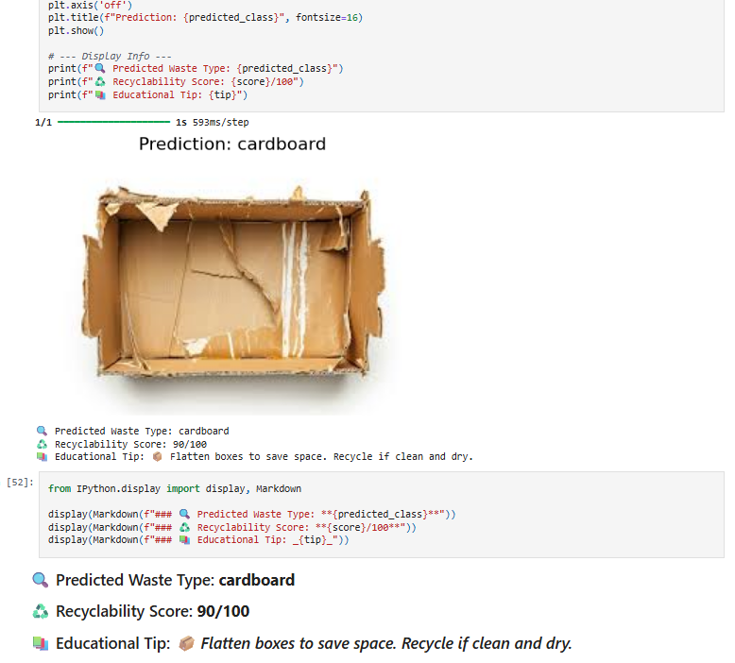
Features and 🔄 Project Upgrade: :
In this upgraded version of the Garbage Classification system, we added:
♻️ Recyclability Score
Each waste category is assigned a score (0–100) showing how recyclable it is.
📚 Educational Content
Provides tips on how to manage, separate, and recycle each type of waste.
💡 Enhanced Output
The model now displays the predicted class, recyclability score, and an educational message to guide users in sustainable waste handling.
Output:

Slide 5

Methodology :
Data Collection
Used Kaggle's TechSash Waste Dataset (~25,000 images)
Data Preprocessing
Resized, normalized, and augmented images
Model Building
Built a CNN with multiple Conv & Pool layers + Dense layers
Model Training
Used 85% of data for training, 15% for testing
Evaluation
Accuracy, confusion matrix, loss curve
Feature Integration
Added scoring & educational content to user interface

Slide 6
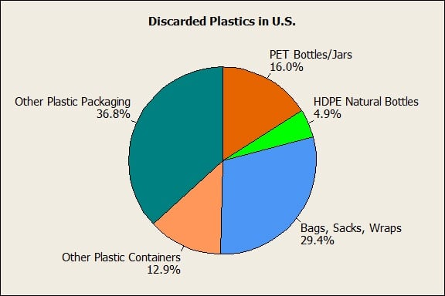
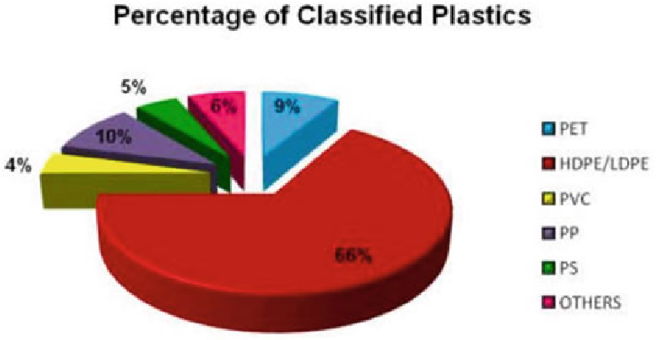
Problem Statement:
Improper waste management is a global challenge. Most waste is still sorted manually, which is time-consuming, inconsistent, and dangerous. There is a growing need for automated, accurate waste classification systems that can distinguish between organic and recyclable materials efficiently

Slide 7
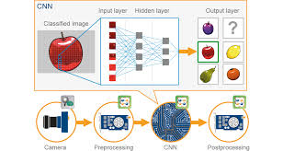
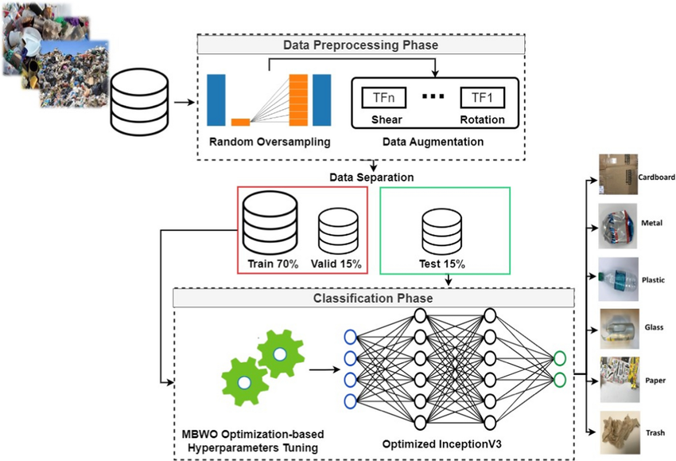
Solution:
We present an AI-powered waste classification system trained on a labeled dataset of organic and recyclable waste. The model uses Convolutional Neural Networks (CNNs) to classify images of waste into two categories.
We also integrate educational modules that guide users on:
How to manage and reduce waste
How to recycle different materials
How to separate waste at the source
And a scoring system to show recyclability of waste items

Slide 8
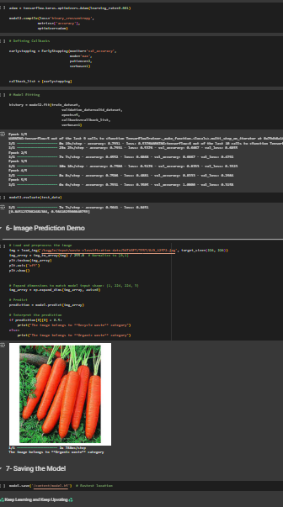
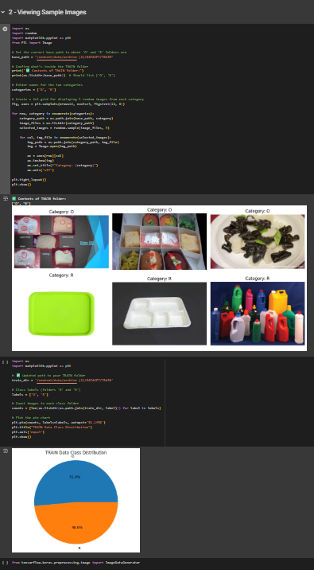
Screenshot of Output:

Slide 9

Conclusion:
This project demonstrates the potential of AI-driven waste classification to improve recycling systems. With high accuracy and educational add-ons, this system can be deployed in schools, homes, and urban smart bins. Empowering users with knowledge and scores about waste management helps drive real change toward a sustainable future.

